Slide 1


CasketSuite

Slide 2
CasketSuite
This Java project has been prepared
under the mentorship of
Bharat Goel sir
by:-
Lakshay Sharma
Shweta Goyal
Tripti Jain
Aman Gupta
Simran Dhamija

Slide 3
Let's get started

Slide 4
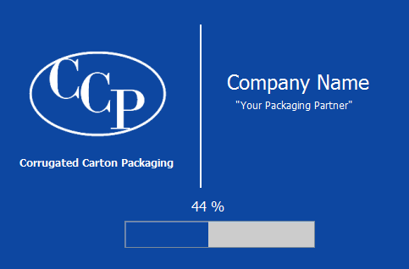
Introduction
This project is an ERP system software for a corrugated box manufacturing company.
It has been made in order to ease the daunting process of managing all the core operations of a business, under one roof.
It covers 4 major modules which are -
Invoicing
Inventory
Accounts
Employee Management

Slide 5
Installation Process

Slide 6
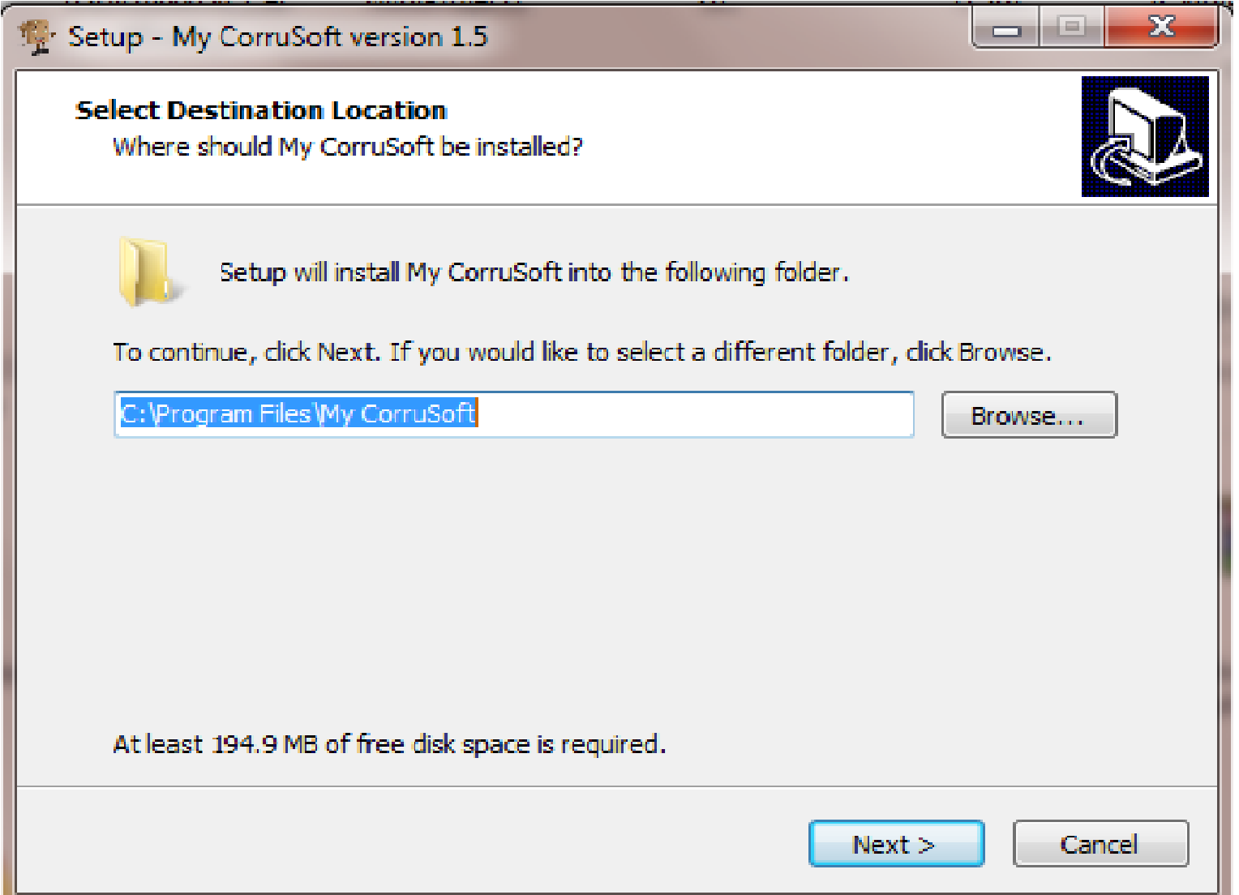
1

Slide 7
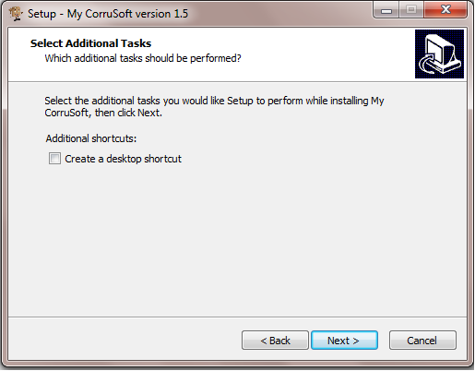
2

Slide 8
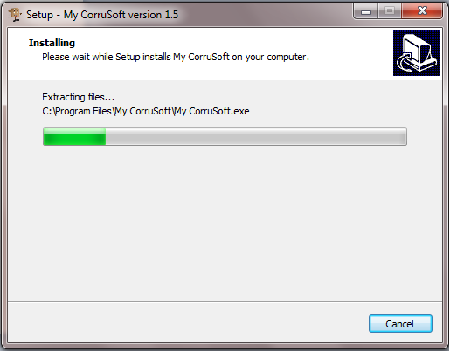
3

Slide 9
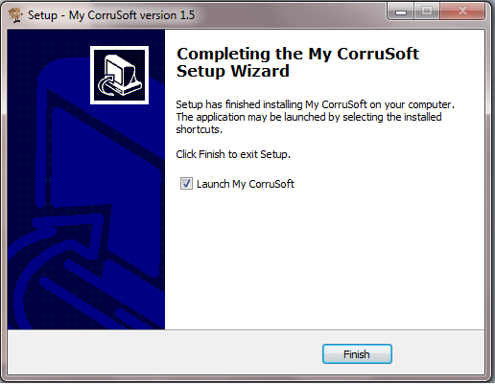
4

Slide 10
Dashboard
After installation, as shown in the previous slide, the foremost step is to get Login.
If you are new, admin can create a new user id through New User.
Modifications in the user details can be made by admin through Modify.
The modules can be accessed only by the authorized person.
It also includes access to PO and Invoice No. (required for later stages).
For changing password, one must click on Forget Password.

Slide 11
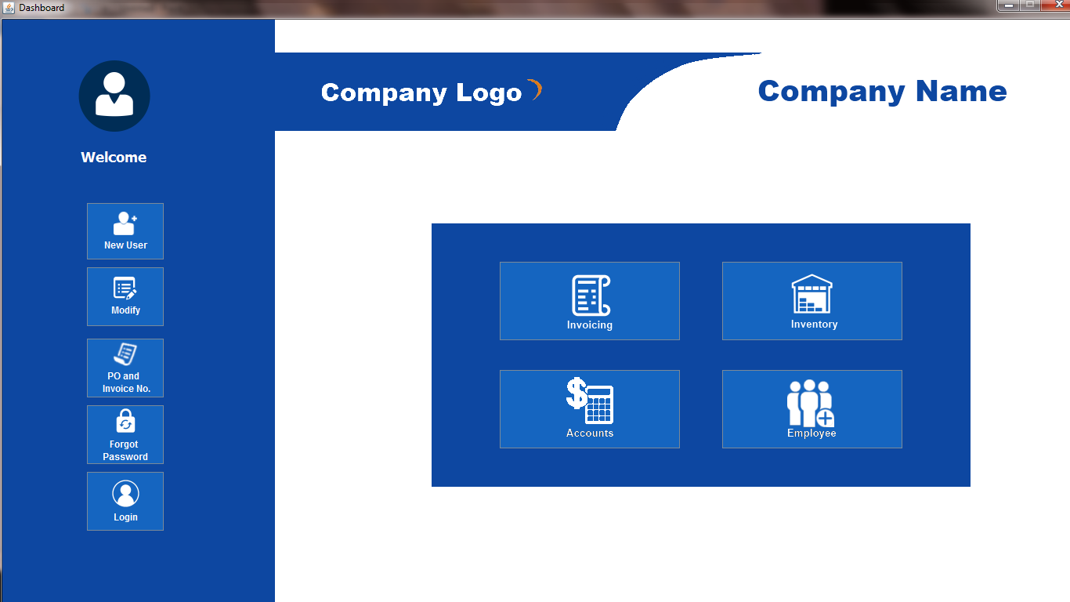
Dashboard

Slide 12
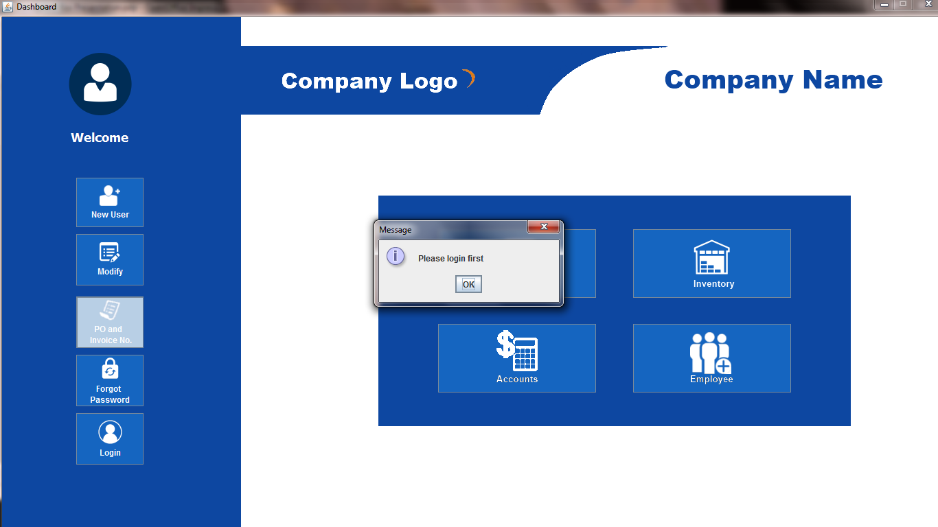
Trying to access anything before login

Slide 13
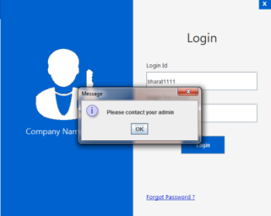
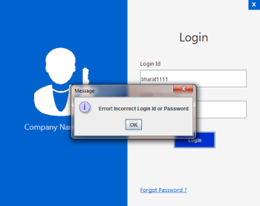
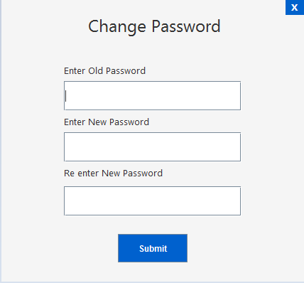
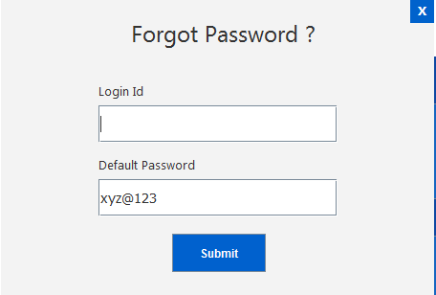
Incorrect id or
pswd
Contact admin. He will set the password to default.

Slide 14
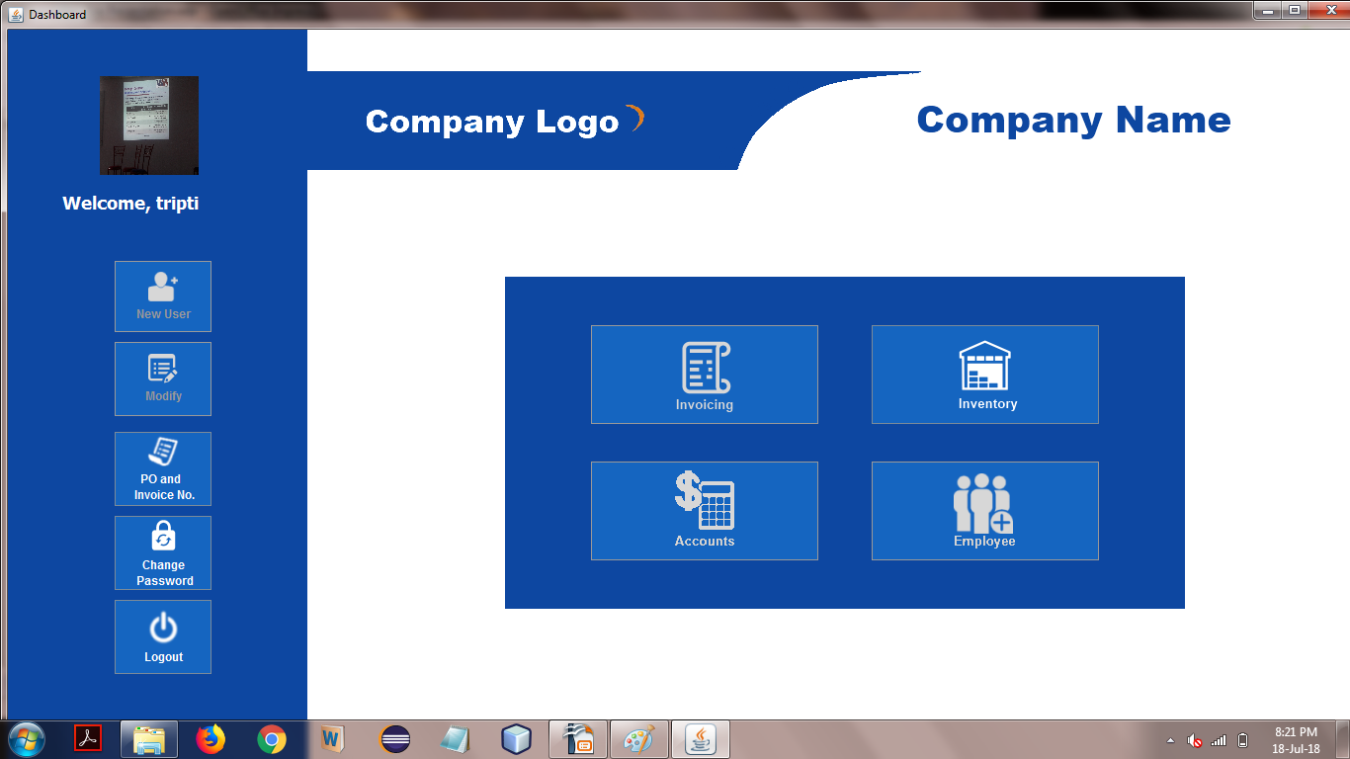
Login by a user other than admin. As per the access rights granted, only Inventory is available for acces to user. Other tabs are disabled.

Slide 15
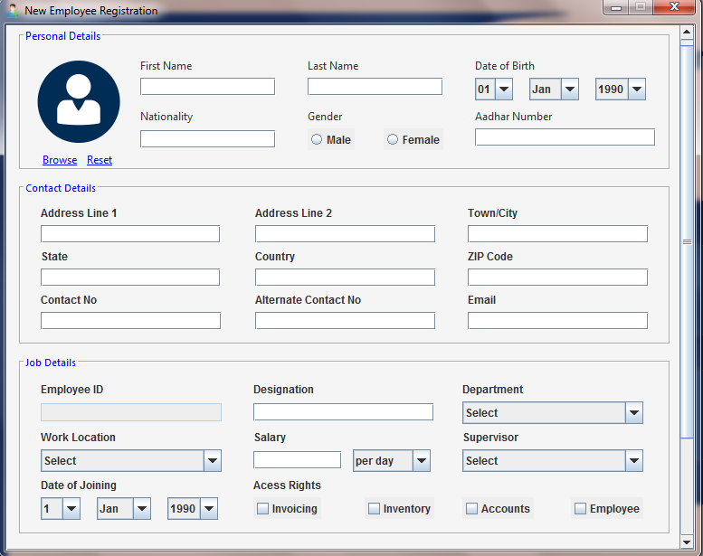
New Employee Registration frame

Slide 16
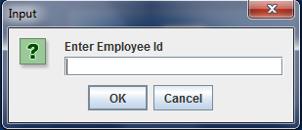
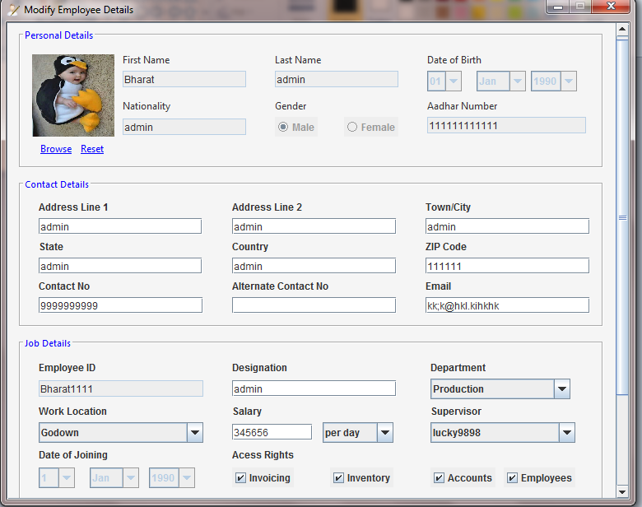
1
Before accessing modification frame
2
Employee details modification frame

Slide 17
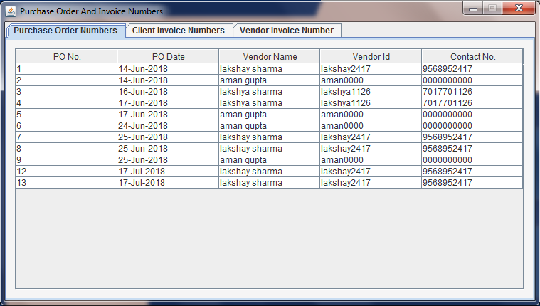
Purchase Order and Invoice No. frame

Slide 18
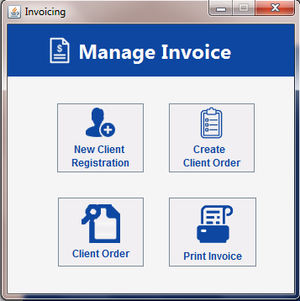
Invoicing
This module includes Client Invoice that covers the part of managing the client requirements for the box specifications.
It covers-
Registration of new client.
Creating Client order.
View Client Order.
Printing Client Order Receipt.

Slide 19
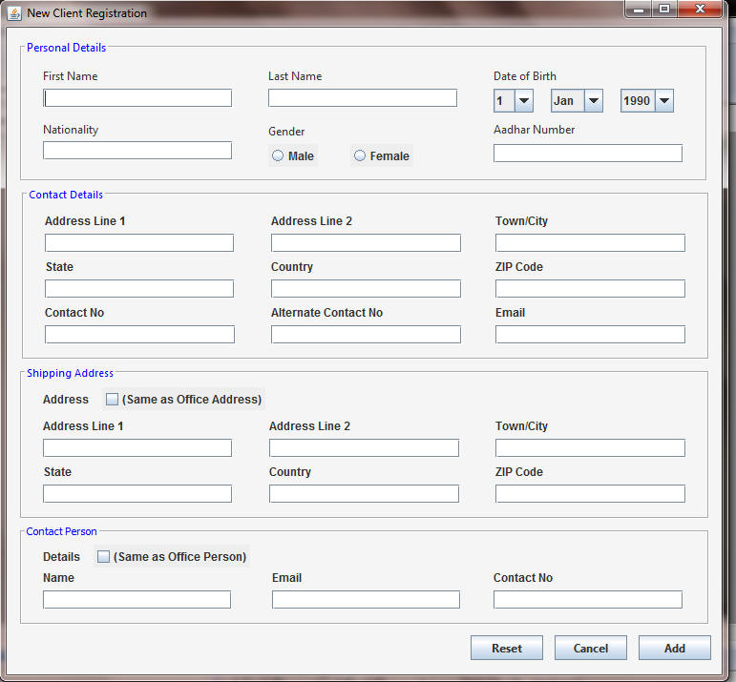
New Client Registration

Slide 20
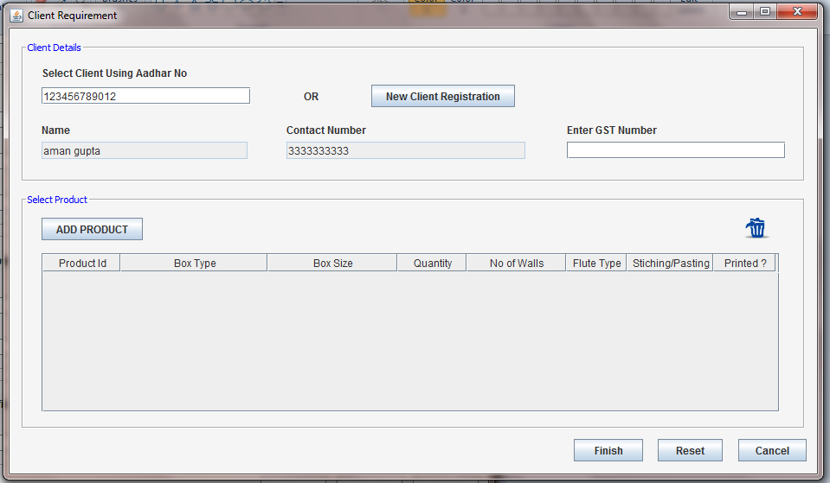
1
Enter Aadhar no. to fetch your details
Client Requirement

Slide 21
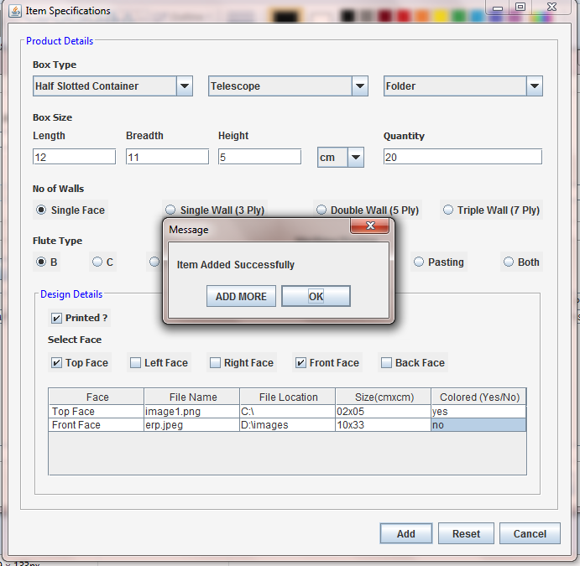
2
Enter details and “ADD”

Slide 22
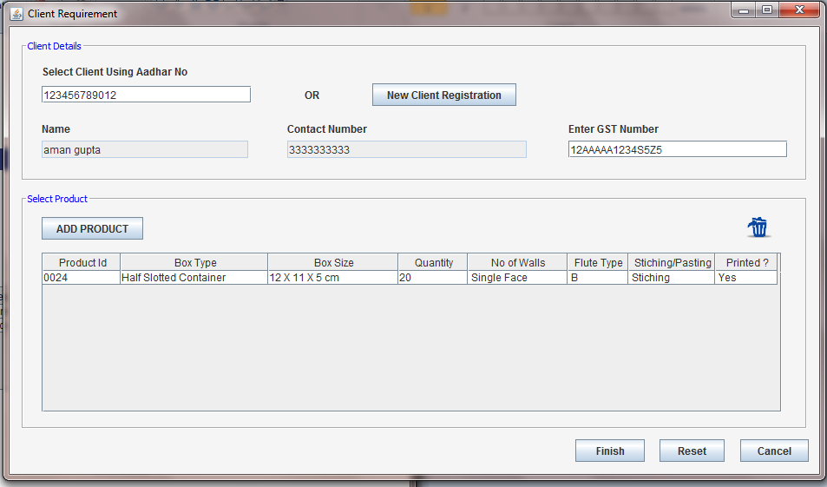
3
Enter GST no. and click “FINISH”

Slide 23
(Both frames can only be accessed by entering emp. id)

Slide 24
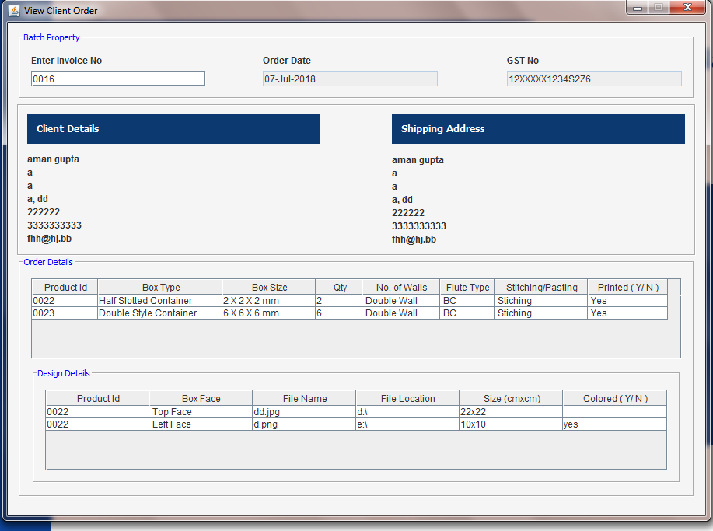
1
View Client Order

Slide 25
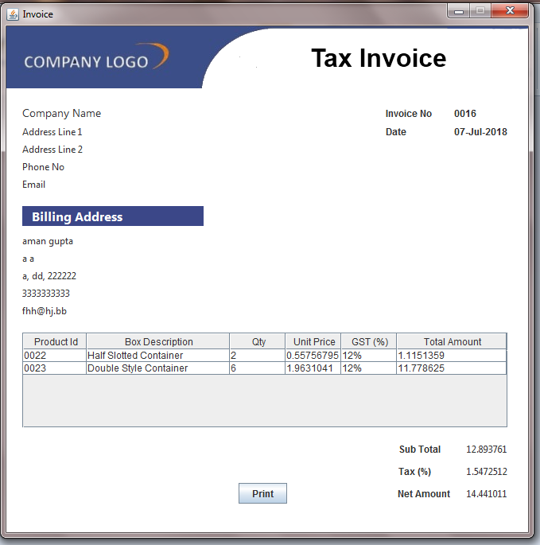
2
Print client order

Slide 26
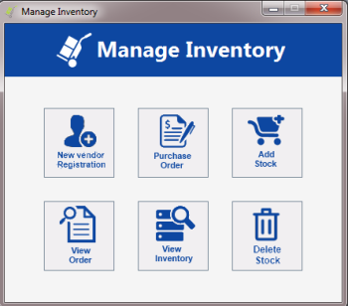
Inventory
This module deals with the inventory related functionality and the vendor related stuff.
It covers-
Registration of new vendor.
Create purchase order.
View purchase order.
Add Stock.
Delete Stock.
View Inventory.

Slide 27
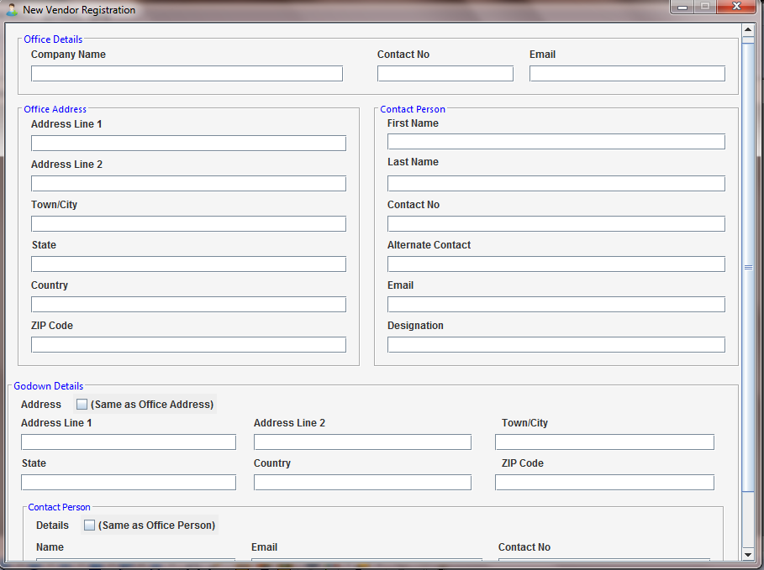
New Vendor Registration

Slide 28
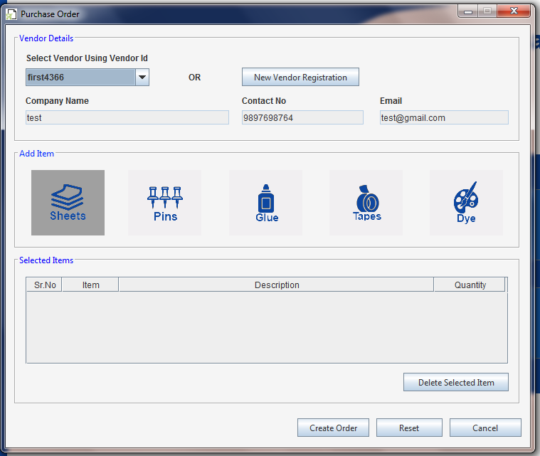
Purchase Order
1

Slide 29
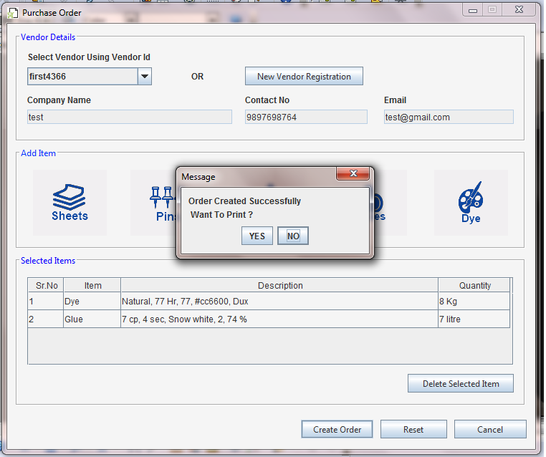
2

Slide 30
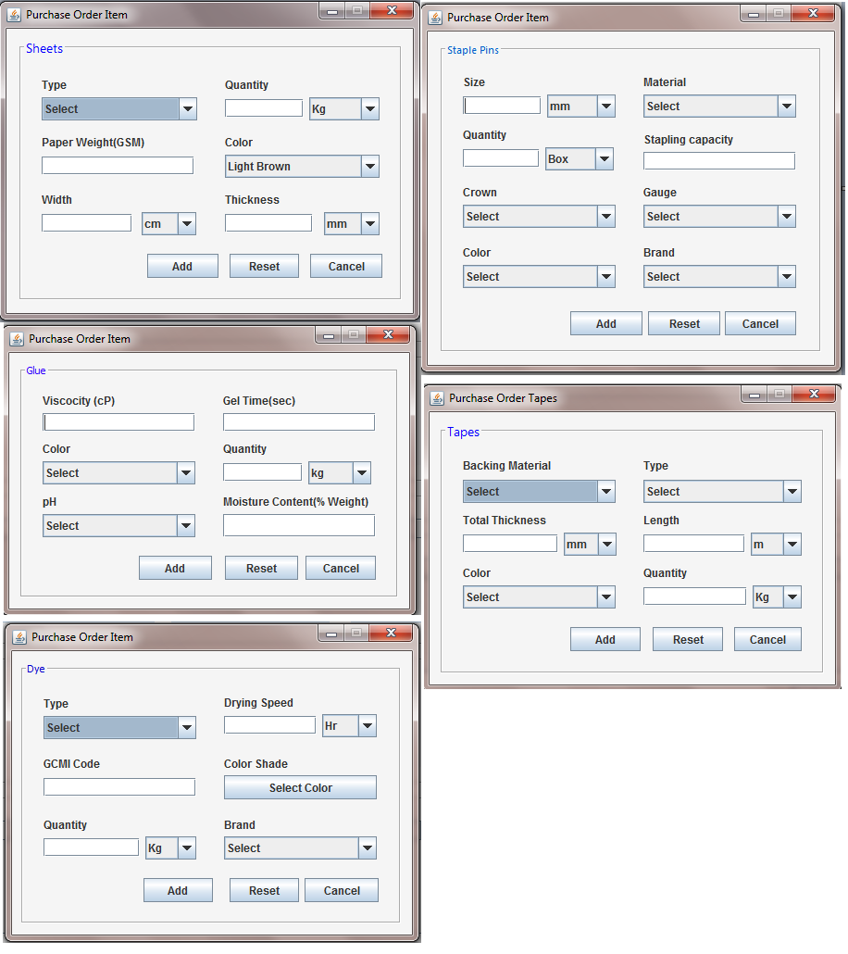
Requirements from vendor. These include items such as -
Sheets
Staple Pins
Glue
Tape
Dye

Slide 31
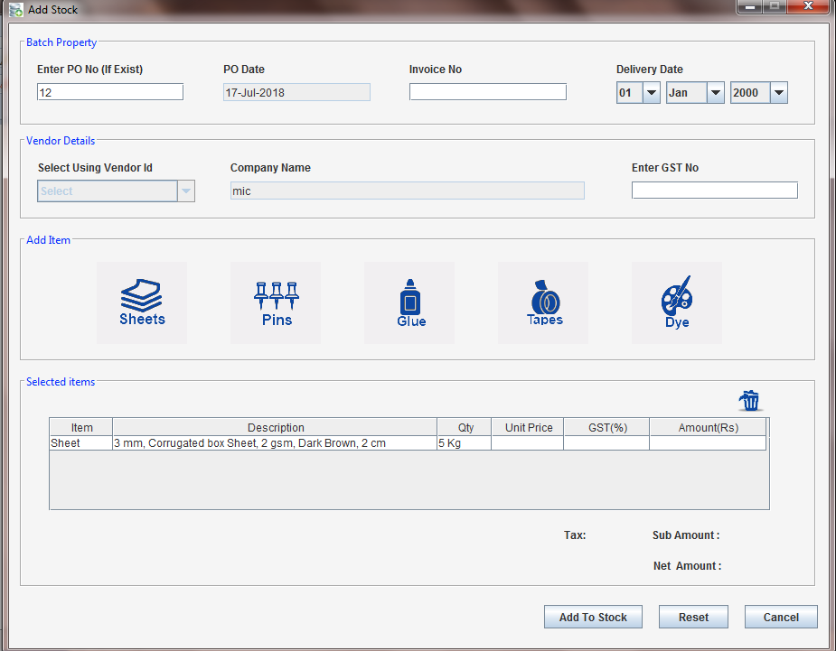
Add Stock received from vendor through purchase order or through vendor id.

Slide 32
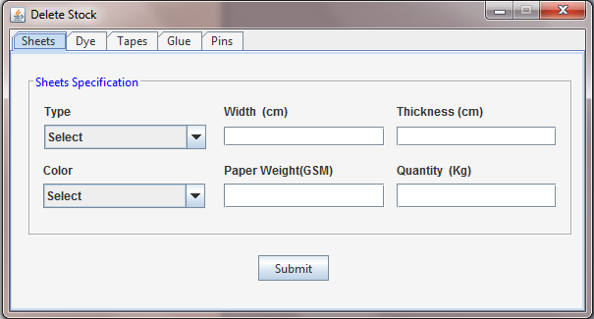
Delete Stock

Slide 33
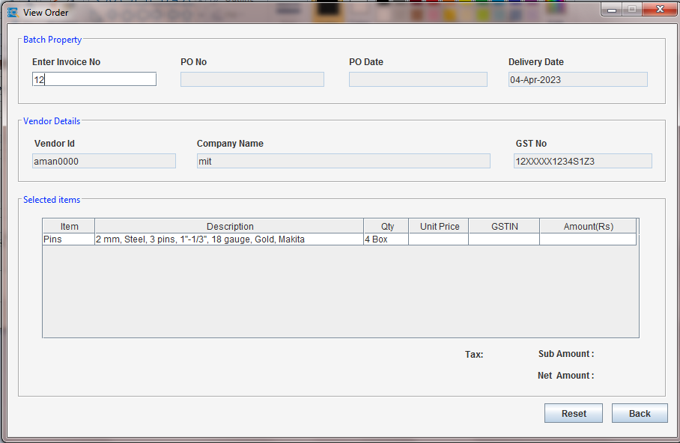
View Order through vendor id

Slide 34
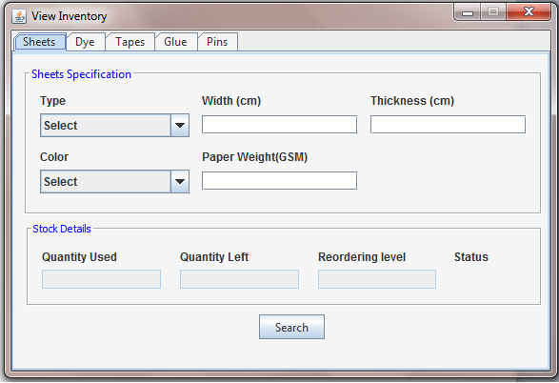
View Inventory

Slide 35
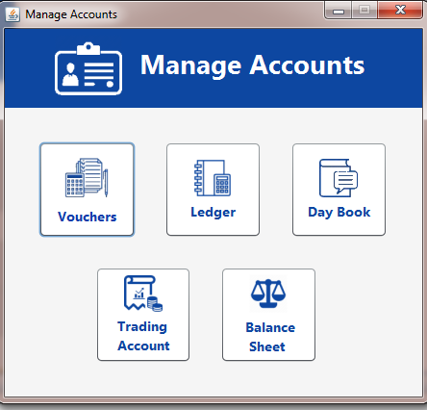
Accounts Management
This is one of the main modules of this project.
It deals with the a/c related functionality and details.
It covers -
Creating ledgers.
Managing Vouchers.
Viewing Day Book.
Viewing Overall a/c and
Balance sheets.

Slide 36
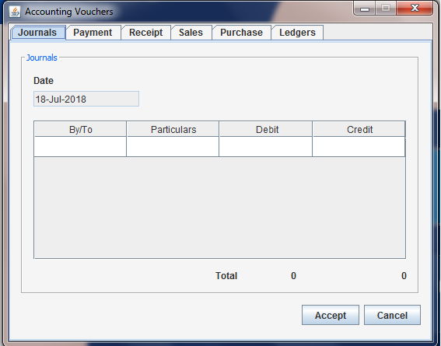
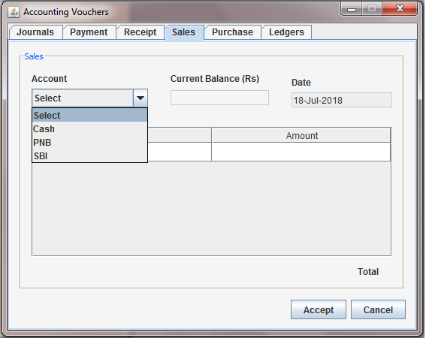
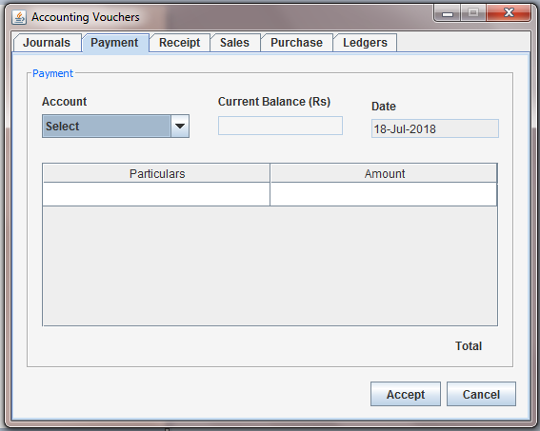
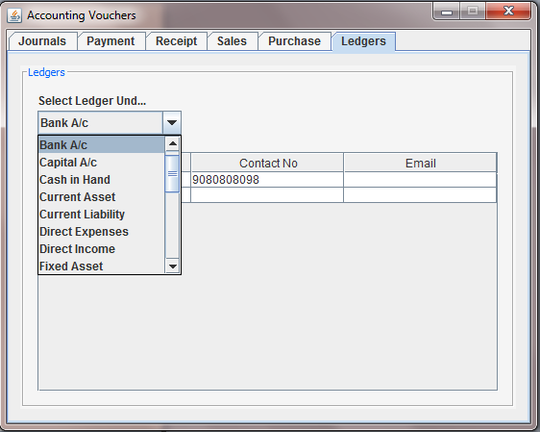
(Accounting Vouchers- Journals, Payment, Receipt, Sales, Purchase, Ledgers List)

Slide 37
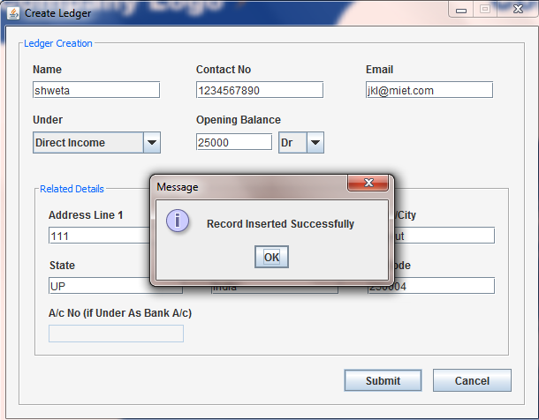
Create Ledger
Create Ledger
Create Ledger

Slide 38
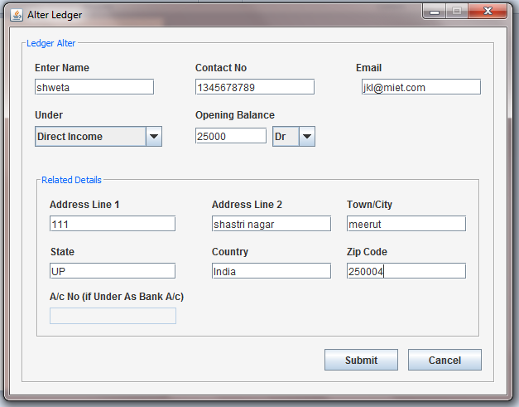
Alter Ledger

Slide 39
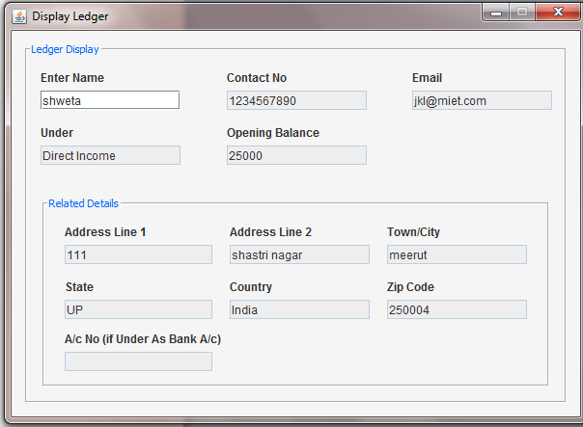
Display Ledger

Slide 40
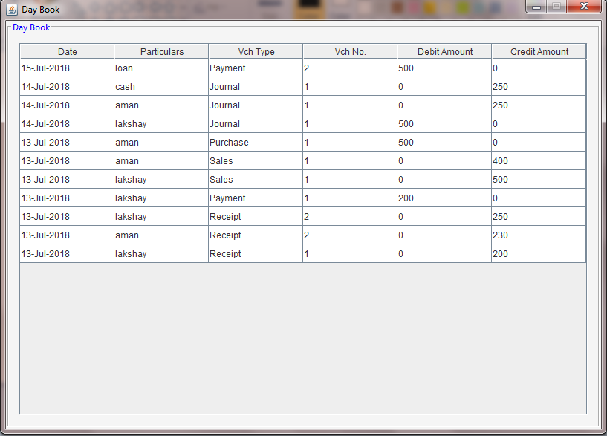
Day Book View

Slide 41
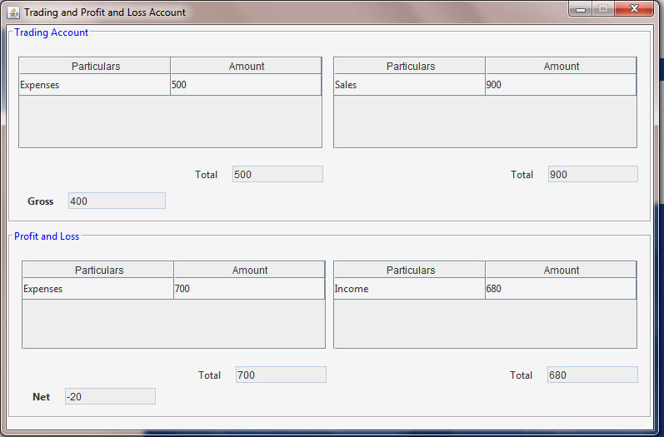
Trading and P/L a/c

Slide 42
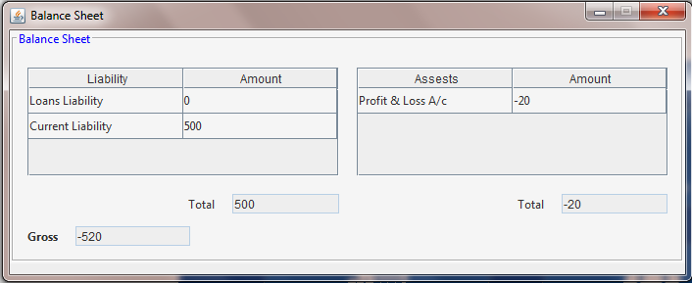
Balance Sheet

Slide 43
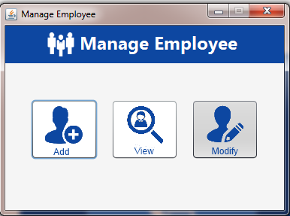
Employee Management
This module deals with the employee details.
It covers -
Add New Employee.
View Employee Details.
Modify Details.

Slide 44
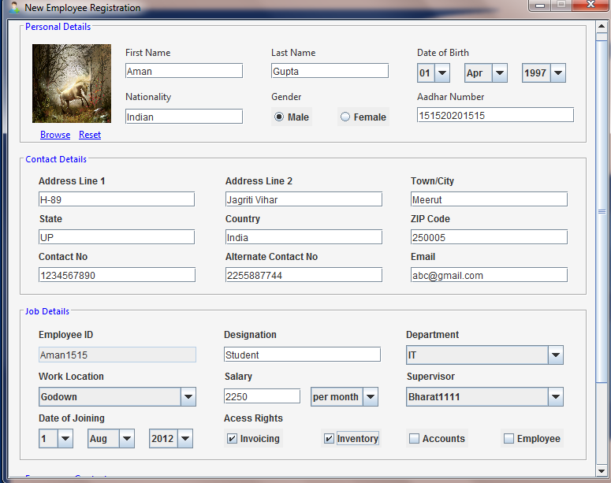
Create Emp.

Slide 45
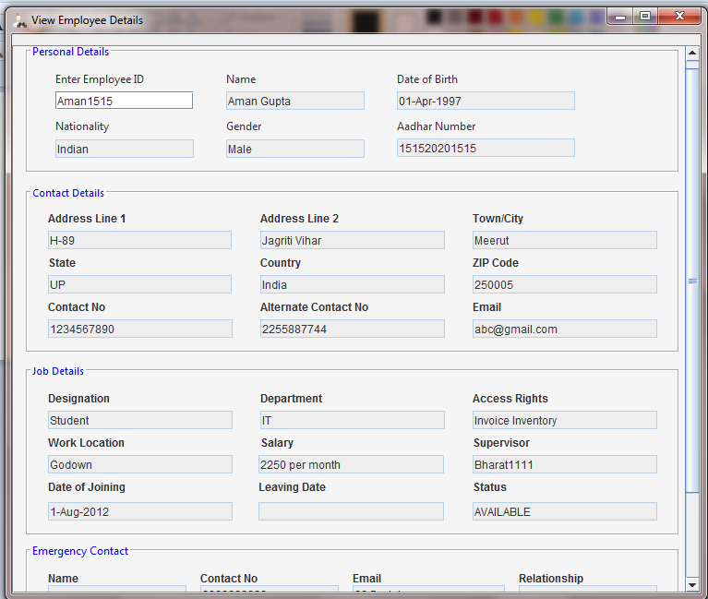
View Emp. Details

Slide 46
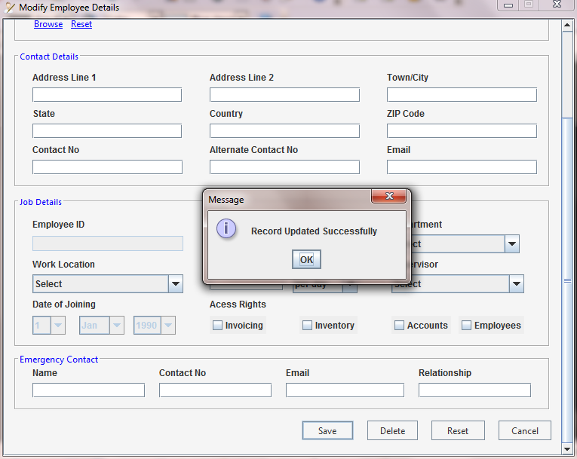
Modify Emp. Details

Slide 47



